Slide 1
Introductory Guide to Surplus Line Information Portal (SLIP) Enhanced California’s Electronic Filing System
Tabs:
Policy
Tags
Invoice Statements
Reports
Users
My Account

Slide 2
Table of Contents
Tabs:……………………………………………….3
Policy Search…………………………………………….4
Tags Search…………………………………………. ….5
Account…………...………………………………………6
Reports……………………………………………………7
Report Criteria……………………………………………8
Users …..…….…………………………………………...9
Settings ….……………………………………………10 -11
Role of Master User……………………………………12

Slide 3
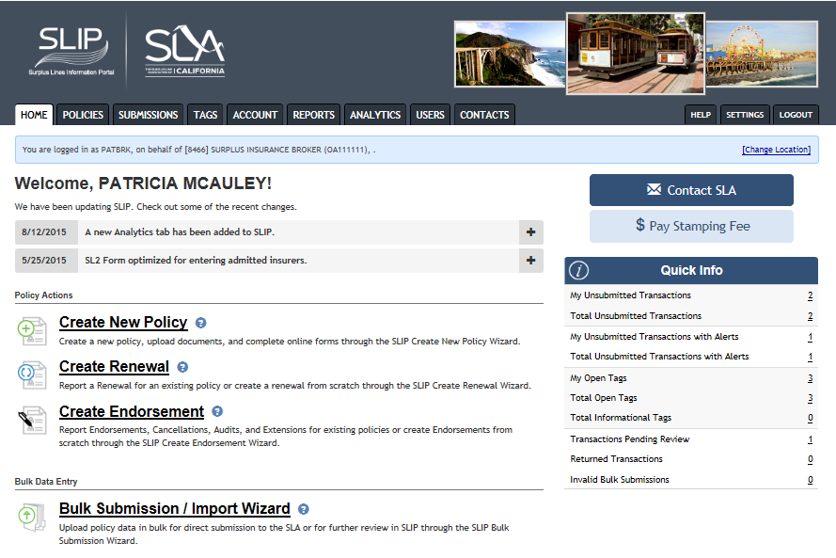
Tabs
There are two search options for transactions and tags on the homepage:
Tabs
Hyperlinks on the Quick Info table
Both search options take you to search screens.
The Submissions tab navigates to the transactions submitted to the SLA.
The Account tab displays the invoices.
The User tab lists the users in your brokerage, including the master user.
1
2

Slide 4
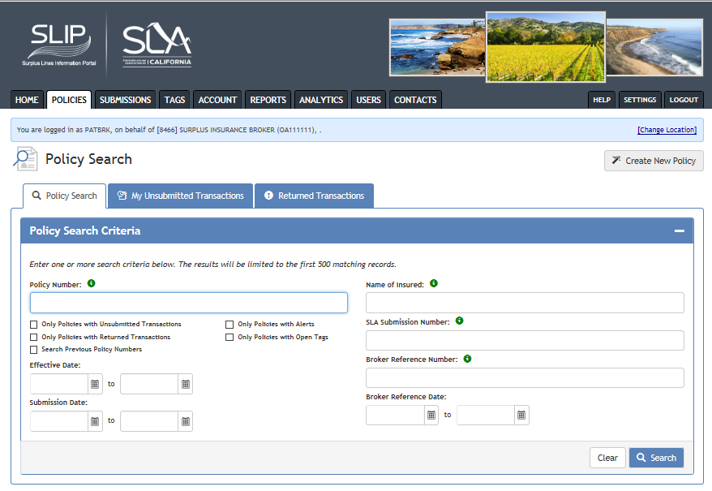
Policy Search Tab
Search for any policy that was processed by the SLA whether it was submitted through SLIP, email or paper.
There are a variety of search options available.
The tab limits the search to only those policies submitted by the logged in user.
My Unsubmitted Transactions

Slide 5
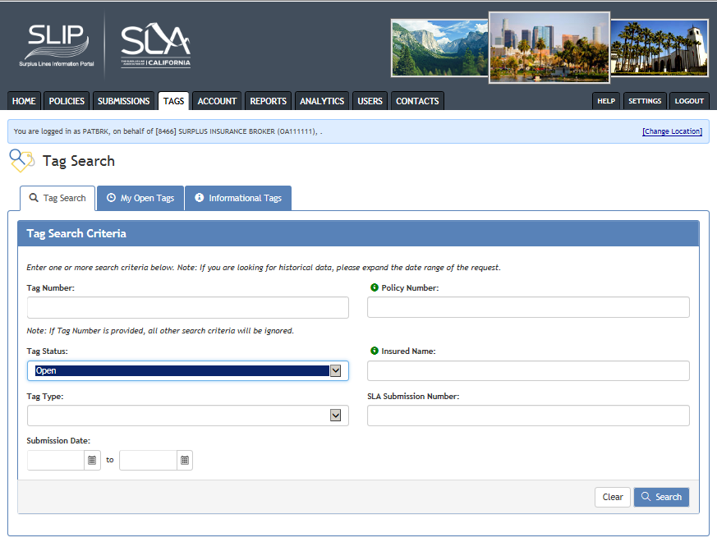
Tags Search Tab
There are three tabs representing different tag categories:
Under the Tag Search tab, enter one or more criteria in the fields.
The drop-down menu for Tag Status allows you to view a list of tags by status (open, response submitted to SLA, closed, or referred to CDI).
Under the My Open Tags tab, a list of open tags for the logged in user displays.
Under the Informational Tags tab, a list of informational tags displays.

Slide 6
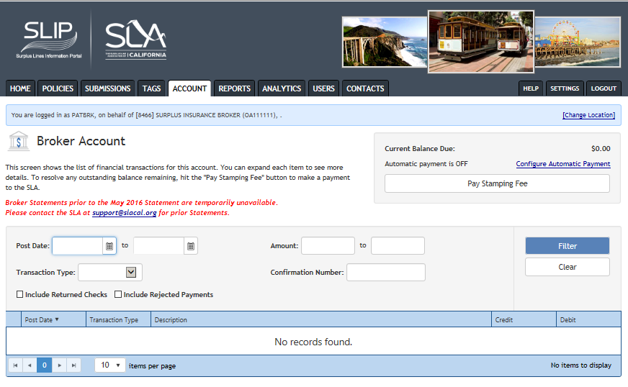
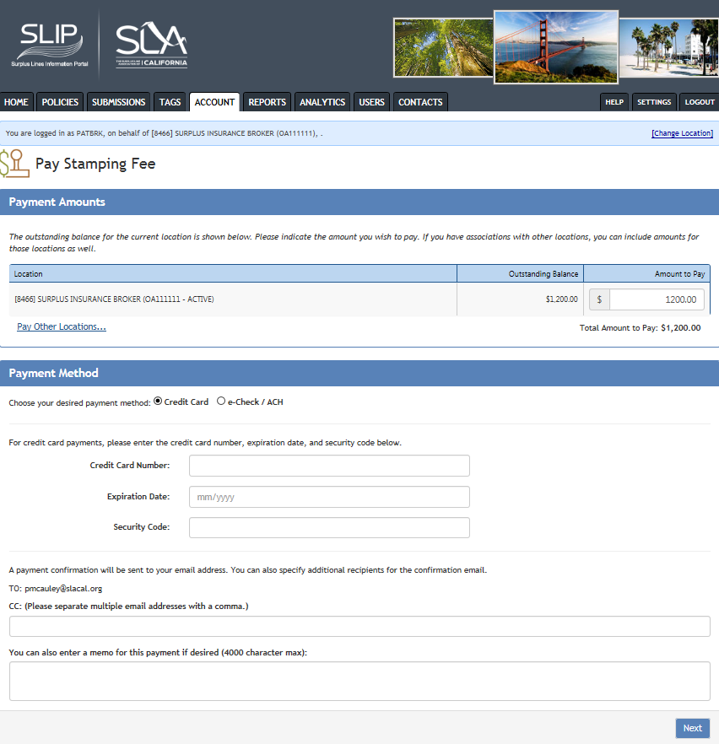
Account Tab
Selecting the Account tab allows you to search for your account statements, review your broker account balance, and pay your stamping fee through SLIP.
Users can choose payment by credit card or e-check/ACH. Fields are enabled depending on your selection.
You can also select autopay.
Payment is credited to oldest outstanding balance.

Slide 7
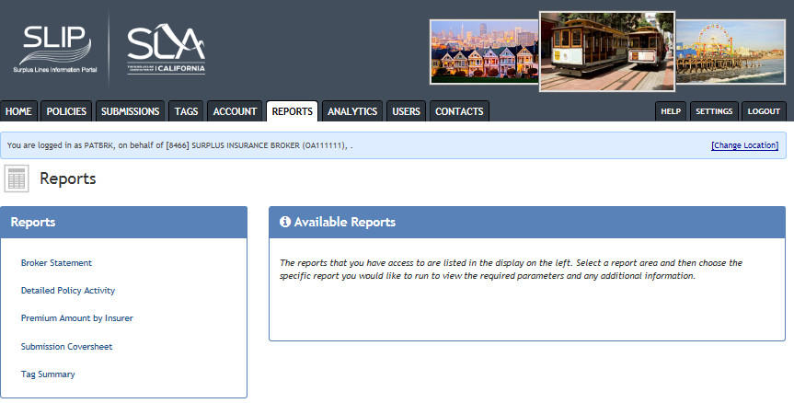
Reports Tab
Select a report from under the Reports heading.
Each report has specific criteria the user must identify.
Choose from the report format of PDF, Excel, or Word.

Slide 8
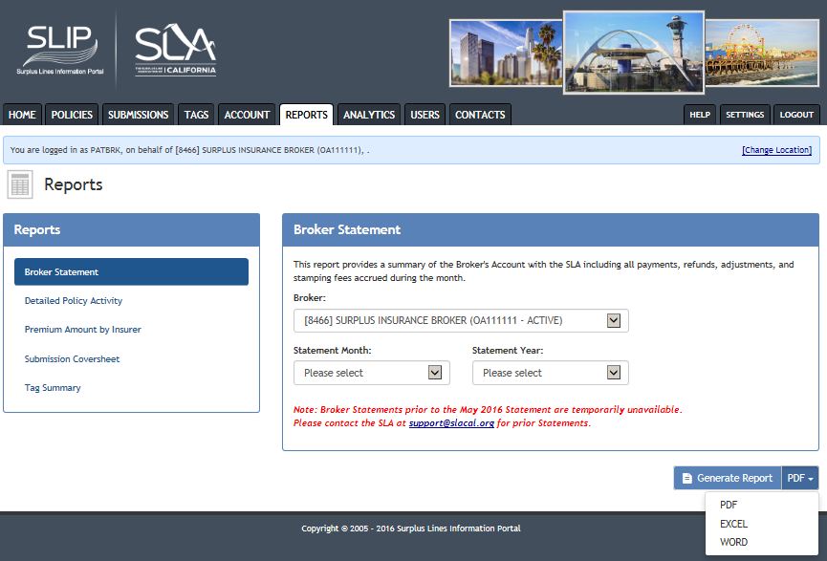
Report Criteria
For the Broker Statement, you must select:
Broker
Statement month
Statement year
Select format
Click the Generate Report button.

Slide 9
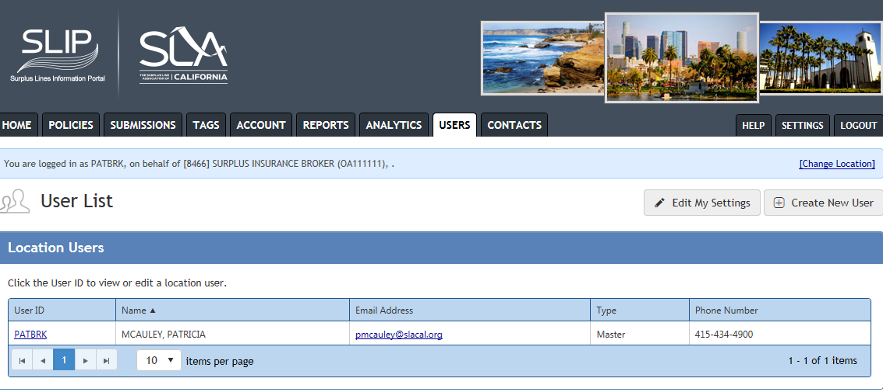
Users Tab
The Users screen lists all the names of the users for a brokerage.
Edit your account information by clicking on the Edit My Settings button or clicking on the User ID hyperlink.

Slide 10
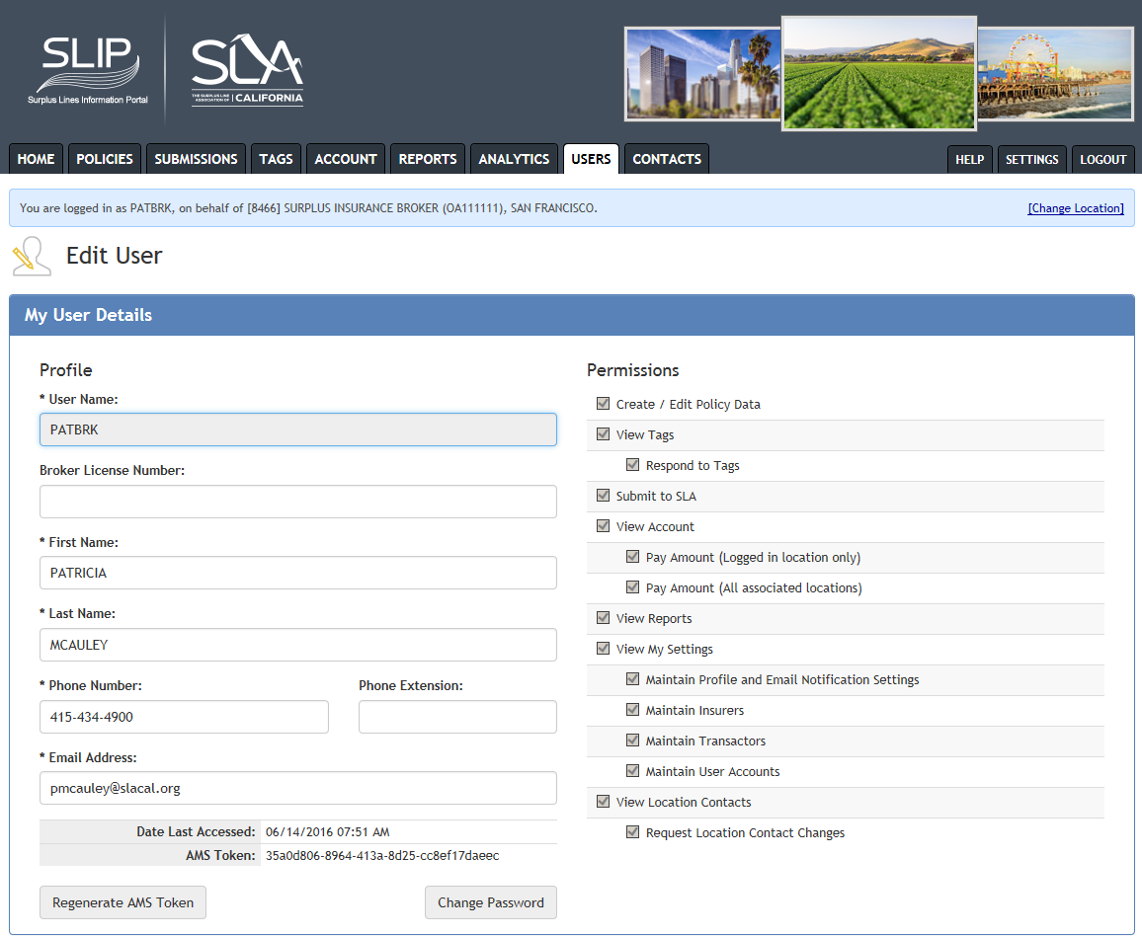
Settings Tab
You can also access your account by selecting the Settings tab on the homepage.
My User Details shows the logged in user’s account information.
The first section of My Account shows your profile and permissions set by your master user.
You can change your password from this screen.

Slide 11
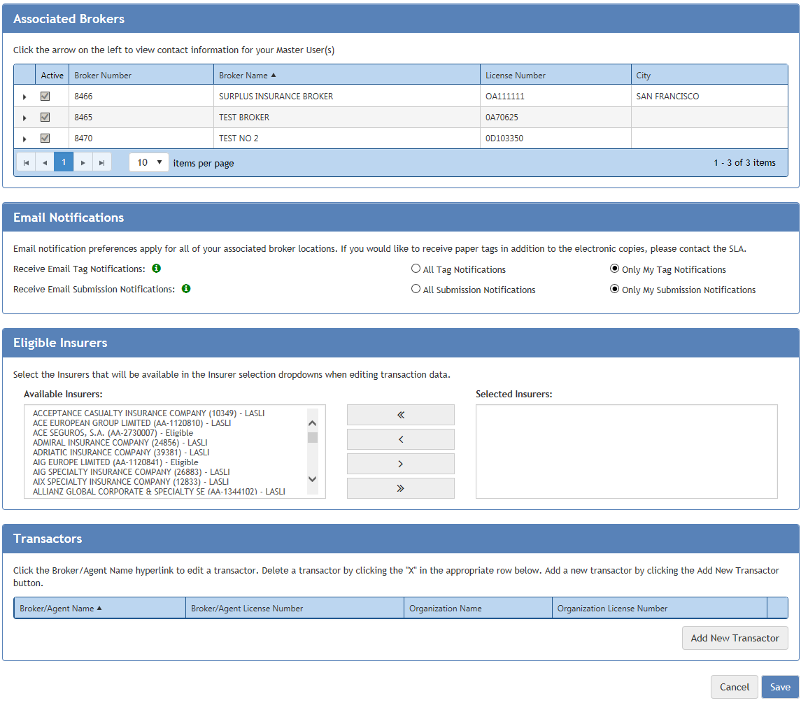
SettingsTab-continued
The other sections of Settings show the associated brokers, insurers and transactors, and type of email notifications set by your master user for your profile.

Slide 12
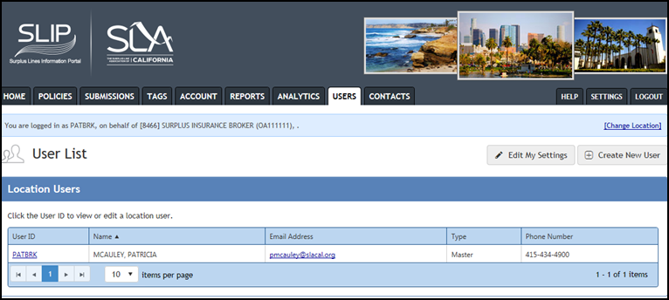
Role of Master User
Under the Users tab, the master user of the brokerage is identified on the Users list.
The master user must contact support@slacal.org to set up his/her profile.
The master user is responsible for setting up the profiles and permissions of the other users in his/her brokerage.

