Slide 1
The State of the P/C Insurance Industry: Emerging from the COVID Era
Surplus Lines Association of California
February 9, 2021
Robert P. Hartwig, PhD, CPCU
Clinical Associate Professor of Finance, Risk Management & Insurance
Darla Moore School of Business ♦ University of South Carolina
Robert.Hartwig@moore.sc.edu ♦ 803.777.6782

Slide 2
Pandemics & P/C Insurance: Outline
P/C Financial Overview & Outlook Amid the COVID-19 Pandemic
Surplus lines review
COVID-19: Actual vs. Expected Impacts on Key Lines
Investment Market Issues: Volatility Rules, Low Interest Rates are Back
The Economy and COVID-19: Overview & Outlook
CAT Loss Update
Commercial Lines Rate Trends & Reinsurance Market Developments
Litigation Trends—Including COVID-19
Summary and Conclusions
Q&A
12/01/09 - 9pm
eSlide – P6466 – The Financial Crisis and the Future of the P/C
Notes:
2

Slide 3
P/C Insurance Industry: Financial Overview Amid the COVID-19 Pandemic
The P/C Insurance Industry Entered the COVID-19 Pandemic from a Position of Financial Strength
Economic, Financial Market, Regulatory and Tort Risks Are Major Challenges Going Forward
3

Slide 4
Policyholder Surplus (Capacity), 2006:Q4–2020:Q3
The P/C insurance industry entered the COVID-19 pandemic from a position strength and was able to withstand the 9.0% surplus decline in Q1 2020 (far less than during the Financial Crisis). 2020 ended with record surplus.
($ Billions)
Financial Crisis (-16.2%)
Drop due to near-record 2011 CAT losses (-4.9%)
Policyholder Surplus is the industry’s financial cushion against large insured events, periods of economic stress and financial market volatility. It is also a source of capital to underwrite new risks.
2010:Q1 data includes $22.5B of paid-in capital from a holding company parent for one insurer’s investment in a non-insurance business.
Sources: ISO, A.M .Best; Risk and Uncertainty Management Center, University of South Carolina.
4
12/01/09 - 9pm
eSlide – P6466 – The Financial Crisis and the Future of the P/C
Notes:
4

Slide 5
P/C Industry Net Income After Taxes, 1991–2020E*
2005 ROE= 9.6%
2006 ROE = 12.7%
2007 ROE = 10.9%
2008 ROE = 0.1%
2009 ROE = 5.0%
2010 ROE = 6.6%
2011 ROAS¹ = 3.5%
2012 ROAS¹ = 5.9%
2013 ROAS¹ = 10.2%
2014 ROAS¹ = 8.4%
2015 ROAS = 8.4%
2016 ROAS = 6.2%
2017 ROAS =5.0%
2018 ROAS = 8.0%
2019: ROAS = 7.7%
2020: ROAS = 4.1%**
$ Millions
COVID’s impact on net income is more modest than assumed early in the pandemic. 21% drop based on annualized Q3 data
*2020 estimate based on annualized actual Q3:20 figure of $35.5B. ROE figures are GAAP; ¹Return on avg. surplus. Excludes Mortgage & Financial Guaranty insurers for years (2009-2014).
**Through Q3 2020.
Sources: A.M. Best, ISO.

Slide 6
ROE: Property/Casualty Insurance by Major Event, 1987–2020:Q3*
(Percent)
P/C Profitability Is Influenced Both by Cyclicality and Volatility
Katrina, Rita, Wilma
Harvey, Irma, Maria, CA Wildfires
Low CATs
2019 7.7%
Sept. 11
Hugo
Lowest CAT Losses in 15 Years
4 Hurricanes
Sandy
Andrew, Iniki
2020:Q3 4.1% Covid-19
Financial Crisis* ROE fell by 8.3 pts from 12.7% to 4.4%
Record Tornado Losses
Northridge
*Excludes Mortgage & Financial Guarantee in 2008 – 2014. 2020:H1 estimate is based on actual Q1 2020 figure of 8.8%.
Sources: ISO, Fortune; USC RUM Center.

Slide 7
Percentage Point Change in P/C ROEs During Past Economic Downturns: 1971 - Present
Change in P/C ROE During Past Economic Downturns (pre-Covid)
Avg.: -4.5% (-4.0% ex. 2000-01)
Median: -5.0% (-3.0% ex. 2000-01)
Percentage Point Change
COVID-19’s economic and financial market impact helped drive down industry ROEs but well within the range of expectation based on history
*2000-2001 decline impacted by 9/11 losses.
**As of Q3 2020 vs. annualized Q3 2019 figure
Source: USC Center for Risk and Uncertainty Management.

Slide 8
P/C Insurance ROE vs. Fortune 500, 1975–2020E*
Average: 1975-2019
Fortune 500: 13.3%
P/C Insurance: 9.0%
ROE
1977:19.0%
1987:17.3%
1997:11.6%
2006:12.7%
2013 9.8%
2020E* 13.0%
2020E 4.1%
2017 5.0%
1975: 2.4%
1984: 1.8%
1992: 4.5%
2001: -1.2%
*2020 Fortune 500 figure is an estimate. P/C figure is actual through Q3 2020.
Profitability = P/C insurer ROEs. 2011-20 figures are estimates based on ROAS data. Note: Data for 2008-2014 exclude mortgage and financial guaranty insurers.
Source: NAIC, ISO, Fortune.

Slide 9
Profitability & Politics
How Is Profitability Affected by the President’s Political Party?
9

Slide 10
P/C Insurance Industry ROE by Presidential Administration, 1950-2020*
OVERALL RECORD: 1950-2020*
Democrats 8.1%
Republicans 7.8%
Party of President has marginal bearing on profitability of P/C insurance industry
*Trump figure is 2017-2020:Q3 average. ROEs for the years 2008-2014 exclude mortgage and financial guaranty segments.
Source: Risk and Uncertainty Management Center, University of South Carolina.

Slide 11
P/C insurance Industry ROE by Presidential Party Affiliation, 1950- 2020*
BLUE = Democratic President RED = Republican President
Reagan/Bush I
Clinton
Bush II
Obama
Carter
Trump
Truman
Eisenhower
Kennedy/ Johnson
Nixon/Ford
*2020 figure is through Q3. ROEs for the years 2008-2014 exclude mortgage and financial guaranty segments.
Source: Risk and Uncertainty Management Center, University of South Carolina.

Slide 12
Growth and Underwriting Performance
COVID-19 Has Had a Mixed Impact on the P/C Insurance Industry
12

Slide 13
Net Premium Growth (All P/C Lines): Annual Change, 1971—2020:Q3
2020F: 3.8%*
2020:Q3: 3.1%
2019: 3.6%
2018: 10.8%
2017: 4.6%
2016: 2.7%
2015: 3.5%
2014: 4.2
2013: 4.4%
2012: +4.2%
(Percent)
1975-78
1984-87
2000-03
Net Written Premiums Fell 0.7% in 2007 (First Decline Since 1943) by 2.0% in 2008, and 4.2% in 2009, the First 3-Year Decline Since 1930-33.
2020 Outlook
Pre-COVID: 3.8%
Through Q3: 3.1%
*Pre-COVID-19 forecast from A.M. Best Review & Preview (Feb. 2020). NOTE: Shaded areas denote “hard market” periods
Sources: A.M. Best (1971-2013, 2020F), ISO (2014-19); Risk & Uncertainty Management Center, Univ. of South Carolina .

Slide 14
2020 Pre- vs. Post-COVID Growth Expectations for P/C Insurance: From Modest to Miserly
Note: 2020 expectations are based on a modestly optimistic scenario for recovery in Q3 and Q4 and that premium volume in Q1 was largely unaffected
Percentage Change in Net Premiums Written
Source: 2020 Pre-COVID-19 figures from Best’s Review & Preview (Feb. 2020); Post-COVID estimates from USC Center for Risk and Uncertainty Management.

Slide 15
P/C Insurance Industry Combined Ratio, 2001–2020:Q3*
Pre-COVID 2020 Combined Ratio Est.
99.1 (A.M. Best)
As Recently as 2001, Insurers Paid Out Nearly $1.16 for Every $1 in Earned Premiums
Relatively Low CAT Losses, Reserve Releases
Higher CAT Losses, Shrinking Reserve Releases, Toll of Soft Market
Relatively Low CAT Losses, Reserve Releases
Sharply higher CATs are driving large underwriting losses and pricing pressure
Heavy Use of Reinsurance Lowered Net Losses
Avg. CAT Losses, More Reserve Releases
COVID-19 has had no discernable net impact on pre-COVID expectations for the combined ratio though Q3 2020;
8.3 pts. due to CATs, about twice avg.
Cyclical Deterioration
Best Combined Ratio Since 1949 (87.6)
Sandy Impacts
Lower CAT Losses
*Excludes Mortgage & Financial Guaranty insurers 2008--2014.
*First 9 months 2020.
Sources: A.M. Best, ISO (2014-2019).

Slide 16
How Have Actual Results Differed from Reality? A Review of Early Predictions of COVID’s Impact on Insurers
US P/C Results Have Generally Been Better than Anticipated
16

Slide 17
Potential Impacts of COVID-19 on Written Premium in 2020, by Key Line
Line | Estimated Premium Impact
Workers Compensation | 12.5% to 25% reduction in premium written in 2020 (equates to $5.9B to $11.75B DWP)
Business Interruption & Contingency | 7% to 13% reduction in premium volume (US & UK)
General Liability* | $1.5B to $6.3B premium reduction in US
Personal Auto | ~$10B in refunds, rebates (equates to ~4% of DWP)
Personal Travel Insurance | 29% to 78% reduction in premium written (US & UK)
Personal/Comm. Motor | ~10% reduction in US; 0% to 11% reduction in UK
Marine/Aviation/Transport | $0.7B-$1.5B (US); $0.6 - $1.2B (UK)
APRIL/MAY 2020 ESTIMATES
*Includes nursing home professional liability.
Source: Derived from Willis Towers Watson, Scenario Analysis of COVID-19 Pandemic (Fig.11, 14), May 2020. and other sources; Risk and Uncertainty Management Center, University of South Carolina.

Slide 18
Potential Impacts of COVID-19 on LOSSES in 2020, by Key Line
Line | Estimated Loss Impact
Workers Compensation | $0.2B - $92B (depends on severity of pandemic and “presumption” determination)
Business Interruption & Contingency | $2B - $22B (US); $1.1B - $13.9B (UK)
General Liability* | $0.7B to $27B loss across US & Bermuda markets
Personal/Comm. Motor | $26B - $57B reduction in personal auto and $4.2B - $9.4B commercial (US); $1 - $7B overall reduction in UK
Mortgage | $0 - $1.7B loss across US & Bermuda markets
D&O | $0.6 - $4.0 loss across US & Bermuda markets
Marine/Aviation/Transport | $0.3B-$1.3B reduction (US); $0.6 - $1.1B (UK)
APRIL/MAY 2020 ESTIMATES
*Includes nursing home professional liability.
Source: Derived from Willis Towers Watson, Scenario Analysis of COVID-19 Pandemic (Fig.11, 14), May 2020. and other sources; Risk and Uncertainty Management Center, University of South Carolina.

Slide 19
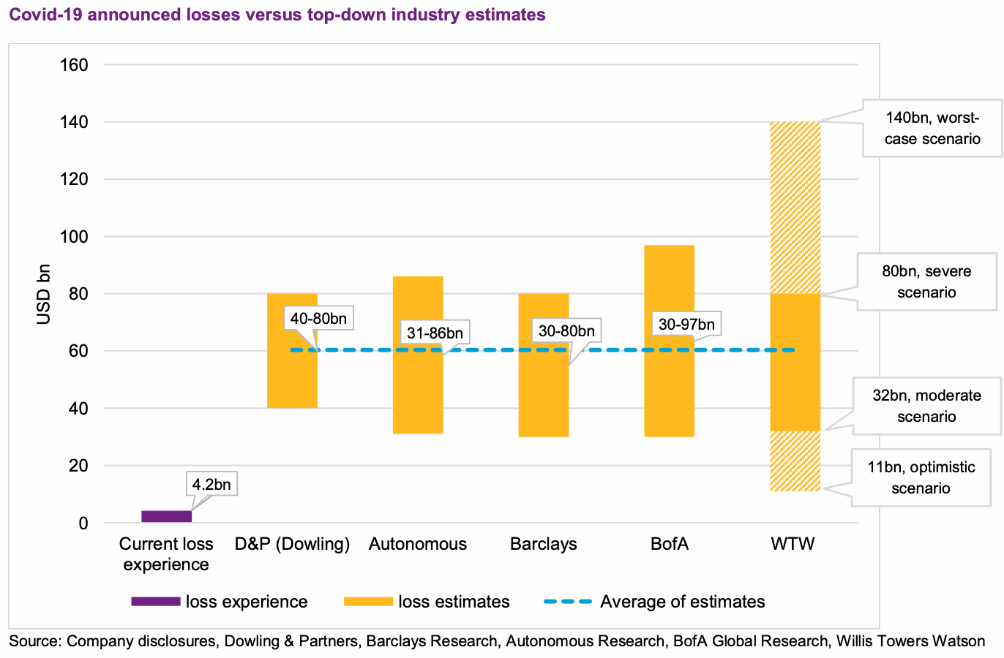
COVID-19 Announced Losses vs. Top-Down Industry Estimates (as of May 12, 2020)
Lloyd’s: Says its own p/c claims could reach $4.3B by June 30. Estimates global p/c losses at $107B; Global investment losses = $96B*
Global P/C COVID-19 loss consensus $30B - $100B (~$60B as midpoint)
30-60bn
APRIL/MAY 2020 ESTIMATES
UBS
Q1 reported COVID claims totaled $4.2B according to Willis, but Q2 will be a truer reflection of actual loss
*Lloyd’s CEO John Neil appearance on CNBC, May 14, 2020: https://www.cnbc.com/2020/05/14/lloyds-of-london-coronavirus-will-be-largest-loss-on-record-for-insurers.html
Sources: Company disclosures, Dowling & Partners, Barclays Research, Autonomous Research, BofA Global Research, UBS Securities, Willis Towers Watson from Artemis.bm accessed at https://www.artemis.bm/news/consensus-emerging-on-30bn-to-100bn-covid-19-industry-loss-willis-re/; Risk and Uncertainty Management Center, University of South Carolina.

Slide 20
Reasons Why P/C Insurance Worst-Case COVID Scenarios Failed to Materialize (So Far)
Economic Recovery Proceeding More Quickly than Anticipated
Rapid Financial Market Recovery (and then some…)
Massive Government Stimulus and Accommodative Fed Policy
Worst-Case Epidemiological Outcome Avoided
Record Pace of Vaccine Development
Employers Did a Reasonably Good Job Protecting Workers from Exposure
Many States Did Not Repeat Spring Lockdowns
Litigation Outcomes Generally Favor Insurers
WC Presumption Expansions Did Not Lead to Explosion in Claims
Offsetting Exposure Reductions in Many Lines
12/01/09 - 9pm
eSlide – P6466 – The Financial Crisis and the Future of the P/C
Notes:
20

Slide 21
BUT… There Is No Questions that the Economic Consequences of COVID Are Massive and Ongoing
The Economic Costs of COVID Vastly Outstrip the Insured Loss Component
21

Slide 22
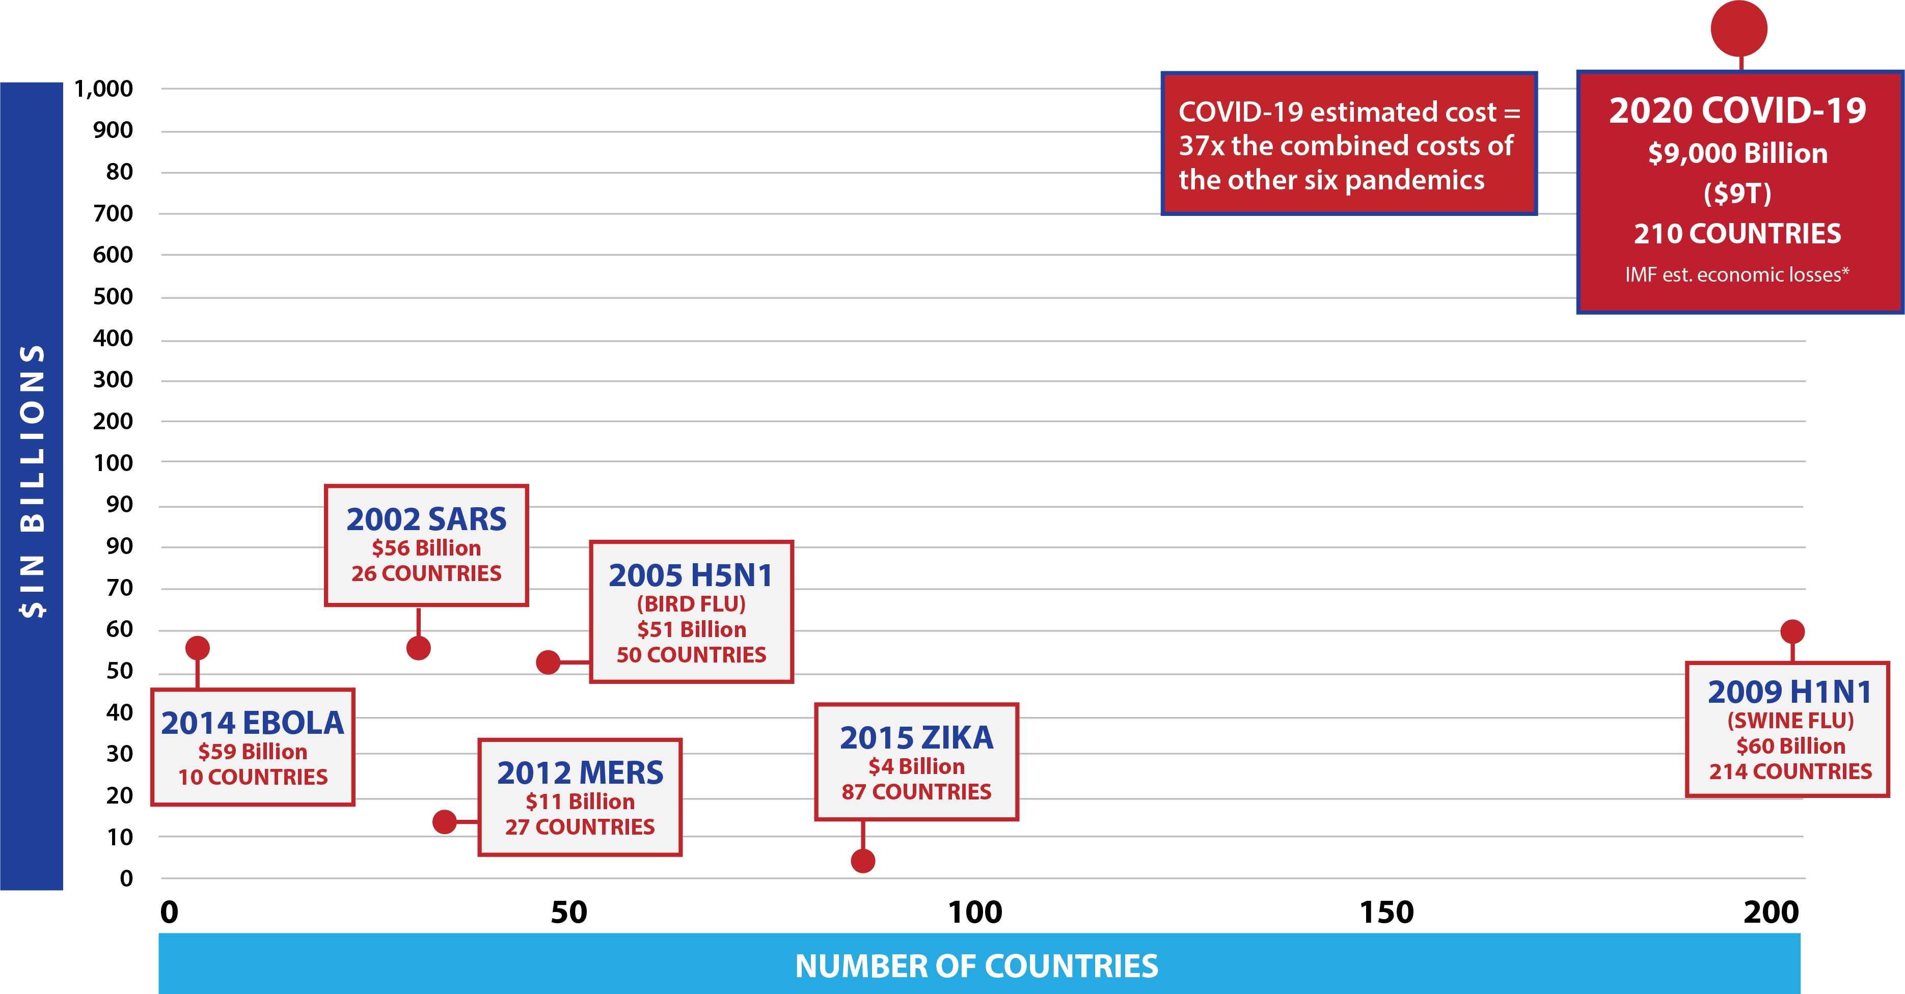
Viral Outbreaks Are Not An Insurable Risk
Economic Losses from Pandemics
Pandemics are frequent, severe, and widespread
(7 pandemics
with multi-
billion$ economic losses in just the last 18 years)
For Reference
2005 Katrina
$58 Billion
2001 9/11
$48 Billion
(insured losses)
*Sources: APCIA using published reports, including IMF, World Bank, Learnbonds.com; APCIA adjustment to 2020 USD

Slide 23
Estimated Monthly U.S. Business Interruption Coronavirus Losses for Small Business—Potential Range (<100 Employees; $Bill)
Monthly BI losses for small business vary widely depending on underlying assumptions but expansive legislation would result in higher estimates; For all businesses <500 employees, BI losses range between $393B - $668B
Source: APCIA, April 2020.

Slide 24
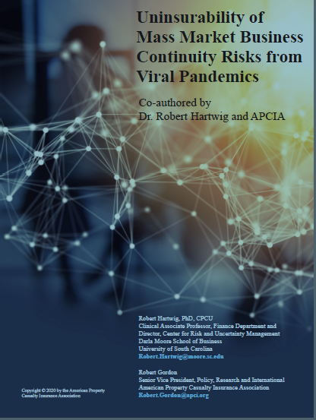
Paper on Insurability of Pandemic Risk
Large scale business continuity risks from pandemics are generally note insurable in the private sector
Business continuity risks are largely undiversifiable within private insurance markets and are highly correlated with other risks (e.g., investment risks)
Large scale business continuity losses pose a potentially systemic risk to the industry and overall economy
Import role for government
Download at: https://www.uscriskcenter.com/wp-content/uploads/2020/05/Uninsurability-of-Pandemic-Risk-White-Paper-Hartwig-APCIA-FINAL-WORD.pdf
12/01/09 - 9pm
eSlide – P6466 – The Financial Crisis and the Future of the P/C
Notes:
24

Slide 25
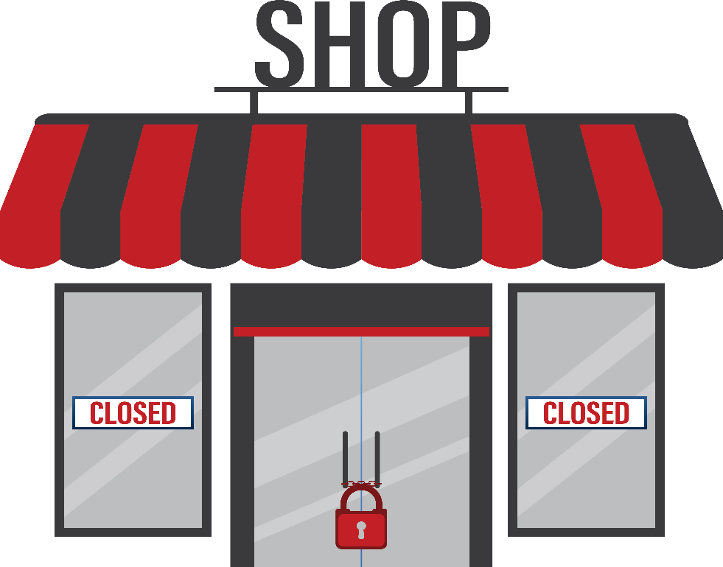
Government Mandated Business Closures Were the Real Black Swan, Not the Coronavirus
The US (and world) has endured several other major infectious disease outbreaks killing 100,000+ Americans without shutting down the economy
Hong Kong Flu (1968-70)
Asian Flu (1957-58)
It is the reaction to the virus that is unprecedented and represents the true Black Swan event
The ramifications of this decision will be consequential for a generation (e.g., $3 trill. in debt)
Sources: CDC; Risk and Uncertainty Management Center, University of South Carolina

Slide 26
COVID-19: Impacts on Premiums and Claims
Economically Sensitive Commercial Lines Were Most Impacted in Terms of Growth
Auto Claims Plunged During the Early Stage of COVID—Will Claims Spike as the Economy Recovers?
26

Slide 27
COVID’s Impact on DPW Growth for Largest P/C Lines: First 9-Mos. 2020 and 2019 vs. Same Period Previous Year
Percent Change: First 9-Most 2020 vs. First 9-Mos. 2019
Workers Comp, Inland Marine and PP Auto Liability have experience the largest decline in DPW
Down $3.5B
Source: A.M. Best, First Look: 9-Month 2020 P/C Financial Results; Risk and Uncertainty Management Center, Univ. of South Carolina.

Slide 28
Personal Auto Claim Frequency Trends Significantly Impacted by COVID: Q2 and Q3 2020 vs. Q2 and Q3 2019
Year-over-Year Change
Collision and PD Liability claims plunged by more than 1/3
Auto Claims Fell Sharply at the Height of the Pandemic, at least through Q3 2020
Source: ISO/PCI Fast Track data for Q3 2020; Risk and Uncertainty Management Center, Univ. of South Carolina.

Slide 29
Surplus Lines Growth
Hard Market, CATs, COVID, Torts, Turbulent Economic Environment Should Benefit E&S Market
29

Slide 30
U.S. Surplus Lines Premium, 2016–2019
$ Billions
CA current accounts for approximately 18% of all surplus lines premium written in the US
Source: A.M. Best.

Slide 31
California Surplus Lines Premium, 2005–2020
$ Billions
Despite COVID, CA surplus lines premiums soared by 22.7% in 2020—and are up 156% since their 2010 trough
During the financial crisis, CA surplus lines premiums plunged by 29.7%
Source: Surplus Lines Association of California.

Slide 32
CA Surplus Lines: Number and Average Value of Transaction, 2005-2020
The average value of surplus lines transactions in CA rose by 9.1% in 2020—and 53.8% since its 2011 trough
The number of CA Surplus Lines transactions was up 12.5% in 2020 and—and 78.4% since 2009
Source: Surplus Lines Association of California.

Slide 33
Reasons for Optimism for Continued E&S Growth
Ongoing high CAT activity
Reduced capacity in in some product segments, geographies
Recovering economy
Post-COVID world will be filled with opportunity for niche pandemic plays
Retrenchment by major (re)insurers from carbon-based energy sector
Adverse/Uncertain tort trends
Continued proliferation of and concern over cyber risk
Asset market volatility/Financial Institution/M&A/SPAC/IPO Risks
12/01/09 - 9pm
eSlide – P6466 – The Financial Crisis and the Future of the P/C
Notes:
33

Slide 34
Catastrophe Loss Update: Major Driver of Rate Pressure
The 2020s Got Off to an Ominous Start
CAT Losses for the 2010s Were Up Materially—Costliest Ever
Primary, Reinsurance and Retro Markets
All Impacted and Are Pressuring Rates
34

Slide 35
2020 U.S. Insured Catastrophe Highlights
$67B in insured nat CAT losses—(3rd costliest year ever behind 2017, 2005)
71 designated PCS CATs, the most in PCS’s 72-year history
10 declared hurricane/TS events, a PCS record (30 named storms in 2020)
~$26B insured losses in North America
17 declared wildfire events, a new record (6 events in 2017 = previous record)
~$11B insured
~5 million CAT claims
18 PCS events with insured losses > $1B, a new record
~$1.5B in insured riot losses + other unusual manmade events (Nashville)
12/01/09 - 9pm
eSlide – P6466 – The Financial Crisis and the Future of the P/C
Notes:
35

Slide 36
U.S. Inflation-Adjusted Insured Cat Losses
Harvey, Irma, Maria
30 named storms, wildfires, riots
67
2020 CAT losses in the US totaled $67B (not including COVID-related losses) from a record 71 PCS events
36
19
20
Average Insured Loss per Year for 1980-2020 is $22.2 Billion
Sources: Property Claims Service, a Verisk Analytics business (1980-2019); 2020 figure from Munich Re; Insurance Information Institute; University of South Carolina, Risk & Uncertainty Management Center.

Slide 37
Top 20 Most Costly Disasters in U.S. History—Katrina Still Ranks #1
(Insured Losses, 2017 Dollars, $ Billions)*
9 of the top 20 mostly costly insured events in US history occurred between 2010 and 2020 (inclusive)
17 of the 20 Most Expensive Insurance Events in US History Have Occurred Since 2004
*Estimated.
Sources: PCS, RMS, Karen Clark & Co; USC Center for Risk and Uncertainty Management adjustments to 2017 dollars using the CPI.

Slide 38
US Property Catastrophe Rate-on-Line Index: 1990 – 2020*
Record CATs in 2017 and high CAT losses in 2018/19 pressured US reinsurance prices in recent years (+9.0% in 2020, +2.6% in 2019, +7.5% in 2018)
(Percent)
Post Katrina, Rita, Wilma period
Post-Ike adjustment
Post-Andrew surge
Adjustment following record tornado losses in 2011 and Sandy in 2012
2020 Global RoL +5%
Post-9/11 Adjustment
US Reinsurance Pricing Is Sensitive to CAT Activity and Ultimately Impacts Primary Insurance Pricing, Terms and Conditions.
*As of January 1 each year.
Source: Guy Carpenter; Artimes.bm accessed at: http://www.artemis.bm/us-property-cat-rate-on-line-index
38
Notes:
38

Slide 39
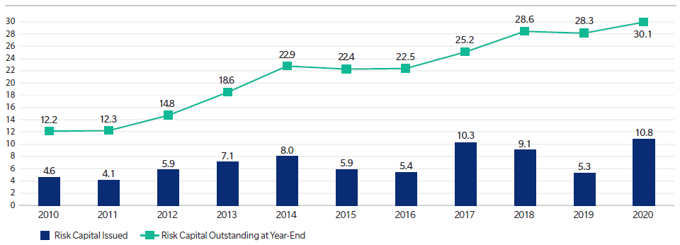
CAT Bond Issuance and Risk Capital Outstanding, 2010 – 2020
Despite COVID, both CAT bond issuance and Risk Capital Outstanding reached new record highs in 2020
Source: Guy Carpenter Securities, January 2021 Renewal Report; Risk and Uncertainty Management Center, University of South Carolina.

Slide 40
INVESTMENTS: THE NEW REALITY
Investment Performance Is a Key Driver of Insurer Profitability
Aggressive Rate Cuts Will Adversely Impact Invest Insurer Earnings
Financial Crisis Déjà Vu?

Slide 41
Property/Casualty Insurance Industry Investment Income: 2000–2020E
($ Billions)
Investment income had just recovered from a decade-long slump. Aggressive Fed actions and recession are pushing interest rates lower and will adversely impact investment income for years to come.
Due to persistently low interest rates, investment income remained below pre-crisis levels for a decade. Lower interest rates post-COVID will drive investment income down once again.
*2020 figure is annualized based on YTD Q3 actual of $37.7B. 2018-19 figures are distorted by provisions of the TCJA of 2017. Increase reflects such items as dividends from foreign subsidiaries.
¹ Investment gains consist primarily of interest and stock dividends. Sources: ISO; University of South Carolina, Center for Risk and Uncertainty Management.

Slide 42
Net Investment Yield on Property/Casualty Insurance Invested Assets, 2007–2020F*
(Percent)
Investment yields remained depressed--down about 150 BP from pre-crisis levels. COVID-19 Fed rate cuts, bond purchases will push asset yield down
The yield on invested assets remains low relative to pre-crisis yields. Fed rate increases beginning in late 2015 through 2018 halted the slide in yields, but rate cuts in 2019/2020 will preclude future gains
Average: 1960-2019 = 4.9%
Low: 2.8% (1961)
High: 8.2% (1984/85)
Sources: NAIC data, sourced from S&P Global Market Intelligence; 2017-19 figures are from ISO. 2020F is from the Risk and Uncertainty Management Center, Univ. of South Carolina.

Slide 43
US Treasury Security Yields: A Long Downward Trend, 1990–2020*
Fed emergency rate cuts and QE in response to the COVID-19 pandemic and market volatility have pushed rates to their levels below those in the financial crisis
Yields on 10-Year US Treasury Notes have been essentially below 5% for more than a decade
10-YR. TREASURY
Jan. 2020: 1.76%
Dec. 2020: 0.93%
Since roughly 80% of P/C bond/cash investments are in 10-year or shorter durations, most P/C insurer portfolios will have low-yielding bonds for many years to come.
*Monthly, constant maturity, nominal rates, through Dec. 2020.
Sources: Federal Reserve Bank at http://www.federalreserve.gov/releases/h15/data.htm. National Bureau of Economic Research (recession dates); Risk and Uncertainty Management Center, University of South Carolina.
12/01/09 - 9pm
eSlide – P6466 – The Financial Crisis and the Future of the P/C
Notes:
43

Slide 44
THE ECONOMY
COVID-19 Pandemic Will Directly and Severely Impact Growth As Exposure Growth Rapidly Shrinks
The Strength of the Economy Has Always Influenced Growth in Insurers’ Exposure Base Across Most Lines
The Links Between the Economy and the P/C Insurance Industry Are Strengthening

Slide 45
Length of US Business Cycles, 1929-Present*
Duration (Months)
Average Duration*
Recession = 13.4 Months
Expansion = 63.8 Months
The most recent economic expansion ended in Feb. 2020 and was the longest in US history (began July 2009)
Will likely take 2+ years to recover lost growth
?
Month Recession Started
* As of August 2020 but excluding current COVID-19 recession which began in Feb. 2020 but with an indeterminate end.
Sources: National Bureau of Economic Research; Risk and Uncertainty Management Center, University of South Carolina.

Slide 46
US Real GDP Growth*
Full Year 2020 was -3.5%, the worst since the end of WW II
Strong 2nd half 2021 growth expected
Real GDP Growth (%)
Financial Crisis
“Great Recession” began in Dec. 2007
COVID CRASH
Q2 2020 plunged by 31.4%
Demand for Insurance Will Be Severely Impacted As the Economy Slows but Is Improving
* Estimates/Forecasts from Wells Fargo Securities.
Source: US Department of Commerce, Wells Fargo Securities 1/21; Center for Risk and Uncertainty Management, University of South Carolina.

Slide 47
The Economy Drives P/C Insurance Industry Premiums: 2006:Q1–2020:Q3* Direct Premium Growth (All P/C Lines) vs. Nominal GDP: Quarterly Y-o-Y Pct. Change
Direct written premiums track nominal GDP fairly tightly over time, suggesting the P/C insurance industry’s growth prospects inextricably linked to economic performance.
Sources: SNL Financial; U.S. Commerce Dept., Bureau of Economic Analysis; ISO; I.I.I.; Risk and Uncertainty Management Center, University of South Carolina.

Slide 48
Unemployment Rate: Jan. 2019 – Dec. 2020
12.4M jobs were created from May through Sept. (after a loss of 22.2M in March/April) helping bring down the unemployment rate to 6.7% from its April peak of 14.7%. So far, ~56% of jobs lost have been recovered. Employment in Dec. 2020 was 6.5% below Feb. 2020.
Unemployment Rate
COVID-19 shutdowns pushed the unemployment rate up to a shocking 14.7% in April before improving beginning in May
Source: US Bureau of Labor Statistics; Risk and Uncertainty Management Center, University of South Carolina.

Slide 49
US Unemployment Rate Forecast: 2007:Q1–2022:Q4
Great Recession
Rising unemployment eroded payrolls and WC’s exposure base.
Unemployment peaked at 10% in late 2009.
The unemployment rate peaked at 14.7% in April (13.1% Q2 avg.)
At 3.5%, the unemployment rate in Feb. 2020 WAS at its lowest point in 50 years.
= forecasts ; = actuals
Sources: US Bureau of Labor Statistics; Wells Fargo Securities (1/21 edition); Risk and Uncertainty Management Center, University of South Carolina.

Slide 50
U.S. National Debt, 1966 – 2020:Q3
($ Trillions)
$27 Trillion
The national debt hit $26.95 Trillion in Q3 2020 and will continue to grow rapidly for the foreseeable future.
Debt/GDP Ratio =127%+ (Great exceeding the previous record of 106% during WW II)
Inflation Alert
Large deficits that increase as a share of GDP are, at some point, unsustainable and inflationary
18
Source: Congressional Budget Office; Federal Reserve Bank of St. Louis: https://fred.stlouisfed.org/series/GFDEGDQ188S

Slide 51
Commercial Lines Growth, Underwriting Performance
& Pricing Cyclicality
Pricing Pressures Are Intensifying
51

Slide 52
Commercial Lines NPW Premium Growth:
1975 – 2020E
ROE
Commercial lines is prone to far more cyclical volatility that personal lines.
Commercial lines premium growth has been sluggish for years, reflecting weak pricing environment.
Economic Shocks, Inflation:
1976: 22.2%
Tort Crisis
1986: 30.5%
Post-9/11
2002: 22.4%
2018: +14.4%
1988-2000: Period of inter-cycle stability
Post-Hurricane Andrew Bump:
1993: 6.3%
Post Katrina Bump:
2006: 7.7%
2020: +3.2%
2019: +6.7%
Recessions:
1982: 1.1%
2016: -1.1%
Great Recession:2009: -9.0%
Note: Data include state funds beginning in 1998.
Source: A.M. Best; Insurance Information Institute; Univ. of South Carolina Center for Risk and Uncertainty Management, ISO.

Slide 53
CIAB: Average Commercial Rate Change, All Lines, 2011:Q1–2020:Q3*
(Percent)
Largest increase since 2003 for some accounts
Renewals turned positive in late 2011 in the wake of record tornado losses and Hurricane Sandy
High CAT losses and poor underwriting results in recent years combined with COVID pressures, reduced capacity, lower interest rates and increased uncertainty are exerting significant pressure on markets with overall rates up by +11.7% as of Q3 2020
*Latest available.
Note: CIAB data cited here are based on a survey. Rate changes earned by individual insurers can and do vary, potentially substantially.
Source: Council of Insurance Agents & Brokers; Center for Risk and Uncertainty Management, Univ. of South Carolina.

Slide 54
Change in Commercial Rate Renewals, by Line: 2020:Q3
Umbrella now leads all major commercial lines in terms of rate gains, exceeding D&O and CP
Percentage Change (%)
All major commercial lines experienced increases in Q2 2020
Auto
Note: CIAB data cited here are based on a survey. Rate changes earned by individual insurers can and do vary, potentially substantially.
Source: Council of Insurance Agents and Brokers; USC Center for Risk and Uncertainty Management.

Slide 55
Litigation Trends—
Including COVID-19
Court Decisions Have Largely Favored Insurers, but Concerns Remain
55

Slide 56
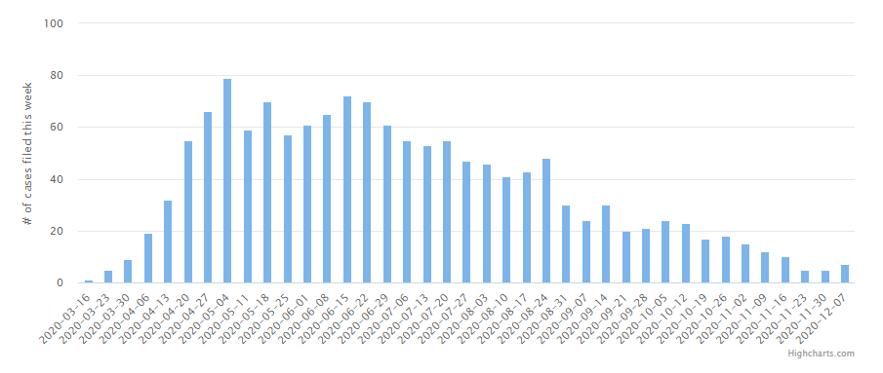
Weekly Number of COVID-Related Lawsuits Filed: (Weeks Ending Mar. 16, 2020 to Dec. 7, 2020) [Latest Available]
The number of new cases filed is declining with just 7 filed the week ending Dec. 7, 2020. Cumulative Total = 1,430
79
7
Source: Covid Coverage Litigation Tracker, University of Pennsylvania School of Law. Accessed 1/21/21 at: https://cclt.law.upenn.edu

Slide 57
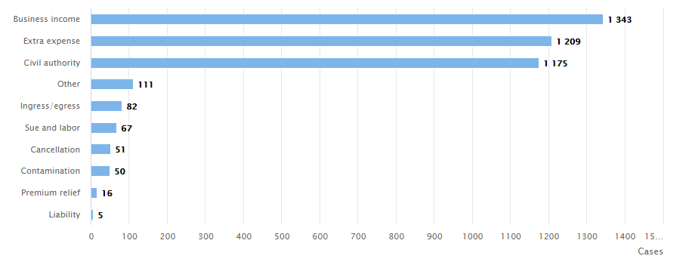
Coverage Sought in COVID-Related Lawsuits: (Total through Dec. 7, 2020) [Latest Available]
Industry is Still at Risk
Jan. 19th the US District Court in Cleveland refused to dismiss a case: Henderson Road Restaurant Systems Inc. Zurich American Insurance Co. Judge claimed that the policy language was ambiguous and that the “microorganism” exclusion was in applicable
On Jan. 14th an OK state judge refused to dismiss a case filed by the Cherokee Nation against AIG’s Lexington unit
BI, Extra Expense and Civil Authority coverage account for the vast majority of cases
Source: Covid Coverage Litigation Tracker, University of Pennsylvania School of Law. Accessed 1/21/21 at: https://cclt.law.upenn.edu

Slide 58
Average Jury Awards, 1999 – 2018 (latest available)
($000)
The average jury award reached an all-time record high in 2017 before falling modestly in 2018.
Median Award in 2018 = $100,000 (a record)
Source: Jury Verdict Research; Current Award Trends in Personal Injury (59th Edition), Thomson Reuters; Risk and Uncertainty Management Center, Univ. of South Carolina.
Notes:
Fig 2-P

Slide 59
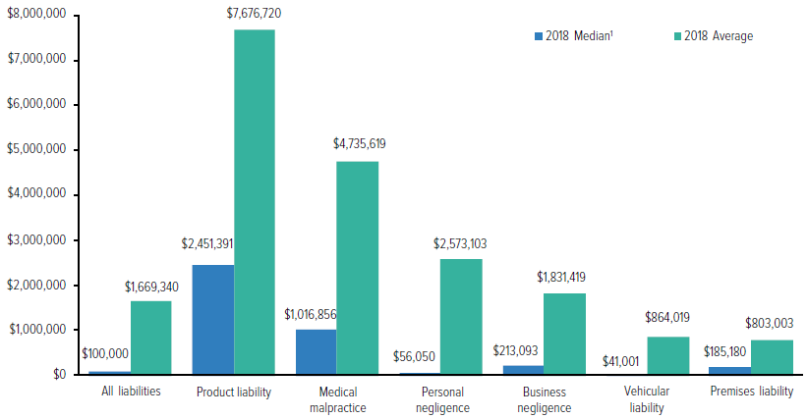
Average and Median Jury Awards, 2018 (latest available)
Products Liability, Business Negligence and Med Mal generate the largest awards
Source: Thompson Reuters, Current Award Trends in Personal Injury (59th ed.); Ins. Info, Inst.; Risk and Uncertainty Management Center, Univ. of South Carolina.
Notes:
Fig 2-P

Slide 60
The Nation’s Judicial Hellholes: 2019 – 2020
Illinois
Cook, Madison & St. Clair Counties
Watch List
Minnesota Supreme Ct./Twin Cities
NYC
CO Supreme Court
Florida
MD General Assem.
MT Supreme Court
PA Supreme Court
WV Supreme Ct.
California
New Jersey Legislature
Dishonorable Mention
St. Louis
Philadelphia Court of Common Pleas
Oklahoma
AK Supreme Court
KS Supreme Court
OR Supreme Court
Louisiana
Florida
Source: American Tort Reform Association; Risk and Uncertainty Management Center, Univ. of South Carolina.

Slide 61
Shareholder Class Action Lawsuits*
Recent
COVID-19
Cannabis
Opioids
Data Breach
CryptocurrencyMeToo
SPACs
Shareholder litigation is surging, in part due to suits associated with M&A activity. Major implications for D&O coverage.
Late 1990s: Tech IPO Flops
Y2K
Increase in M&A
*As of Feb. 1, 2021.
Source: Stanford University School of Law (securities.stanford.edu); Risk and Uncertainty Management Center, Univ. of South Carolina.

Slide 62
SUMMARY
The P/C Insurance Industry Remains Strong, Stable, Sound and Secure—Strong Case for Continued E&S Growth
Worst-Case Scenarios Have, So Far, Been Averted
An Anticipated Acceleration in the Economic Recovery in the Second Half of 2021 Should Help Restore Most P/C Exposures to Pre-Pandemic Levels by mid-2022
Asset Price Volatility Will Persist and Low Interest Rates Will Pressure Investment Earnings for Years
COVID-19 Exposures Are Manageable with Headline Risk on BI and WC Issues
62
12/01/09 - 9pm
eSlide – P6466 – The Financial Crisis and the Future of the P/C
Notes:
62

Slide 63
Thank you for your time and your attention!
Twitter: twitter.com/bob_hartwig
For a copy of this presentation, email me at robert.hartwig@moore.sc.edu or
Download at www.uscriskcenter.com

